Slide 1
Enthalpy L2
11 Chemistry

Slide 2
Learning objectives
• Sketch enthalpy level diagrams for exothermic and endothermic reactions.
• Analyse enthalpy level diagrams and thermochemical equations to determine the relative stabilities of reactants and products, and the sign of the enthalpy change (ΔH) for a reaction.

Slide 3
Recap: Endothermic & exothermic reactions
Endothermic – net absorption of energy
Products have more stored energy than the reactants.
Heat is absorbed from the surroundings.
Exothermic – net release of energy
Reactants have more stored energy than the products.
Heat is released to the surroundings.

Slide 4
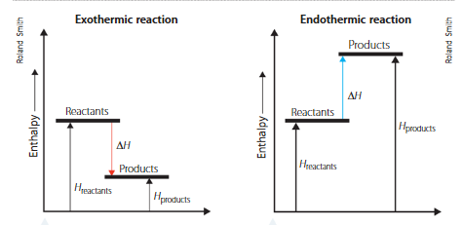
Enthalpy level diagrams
Endothermic Reactions
The reaction is absorbing energy, so the products will have more energy than the reactants
Feels ‘cold’ to touch, as the reaction absorbs heat from the surroundings
Reactants are thermodynamically more stable than the products
Energy is constantly needed for the reaction to occur.
E.g. boiling water
H₂O(l) + energy → H₂O(g)

Slide 5
Enthalpy level diagrams
Exothermic Reactions
The reaction is releasing energy, so the products will have less energy than the reactants
Feels ‘hot’ to touch, as the reaction releases heat into the surroundings
Products are thermodynamically more stable than the reactants
E.g. combustion of methane
CH₄(g) + O₂(g) → CO₂(g) + H₂O(l) + energy

Slide 6
Enthalpy
Endothermic Reactions
Exothermic Reactions
Total chemical energy of the products more than the total energy of the reactants.
ΔH = H_{products} – H_{reactants}
ΔH = positive number
i.e the system has
gained energy
Total chemical energy of the products less than the total energy of the reactants.
ΔH = H_{products} – H_{reactants}
ΔH = negative number
i.e. the system has lost
energy to the surroundings

Slide 7
Check your understanding
Consider;
C₆H₁₂O_{6(aq)} + O_{2(g)} → CO_{2(g)} + H₂O_{(l)} ΔH = -2803kJ/mole (for a balanced equation)
Is this reaction Exothermic or endothermic? Explain your answer.
Balance the equation above.

Slide 8
Check your understanding
Consider;
C₆H₁₂O_{6(aq)} + 6O_{2(g)} → 6CO_{2(g)} + 6H₂O_{(l)} ΔH = -2803kJ/mole
Is this reaction Exothermic or endothermic? Explain your answer. ΔH is negative, so energy is released into the system.
Balance the equation above.

Slide 9
Thermochemical equations
Consider;
C₆H₁₂O_{6(aq)} + 6O_{2(g)} → 6CO_{2(g)} + 6H₂O_{(l)} ΔH = -2803kJ/mole
The enthalpy (ΔH) is related to the number of moles (molar ratio) in a balanced equation. If the number of moles /molar ratio changes, ΔH changes accordingly.
2C₆H₁₂O_{6(aq)} + 12O_{2(g)} → 12CO_{2(g)} + 12H₂O_{(l)} ΔH = -5606kJ/mole
3C₆H₁₂O_{6(aq)} + 18O_{2(g)} → 18CO_{2(g)} + 18H₂O_{(l)} ΔH = -9409kJ/mole
The no. moles doubled, so did the ΔH!
The no. moles tripled, so did the ΔH!

Slide 10
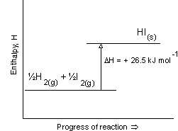
Check your understanding
Identify:
The reactants
The products
State whether reactants or products are more thermodynamically stable. Hint: which one has less energy?
Identify whether the reaction is exothermic or endothermic.
Balance the reaction and calculate ΔH for the balanced reaction.

Slide 11
Thermochemical equations
H₂O_{(l)} → H₂O_{(g)} ΔH = +41kJ/mole
H₂O_{(s)} → H₂O_{(l)} ΔH = +6kJ/mole
Are these reactions endo or exothermic?
Which reaction requires more energy to go ahead?
Notes:
Thermo = heat (e.g. thermal springs are hot springs!)

Slide 12
Thermochemical equations
Compare:
CH_{4(g)} + O_{2(g)} → CO_{2(g)} + H₂O_{(l)} ΔH = -890kJ/mole
CO_{2(g)} + H₂O_{(l)} → CH_{4(g)} + O_{2(g)} ΔH = +890kJ/mole
Are these reactions endo or exothermic?
Are there specific conditions we might need to make one/both reactions occur?

Slide 13
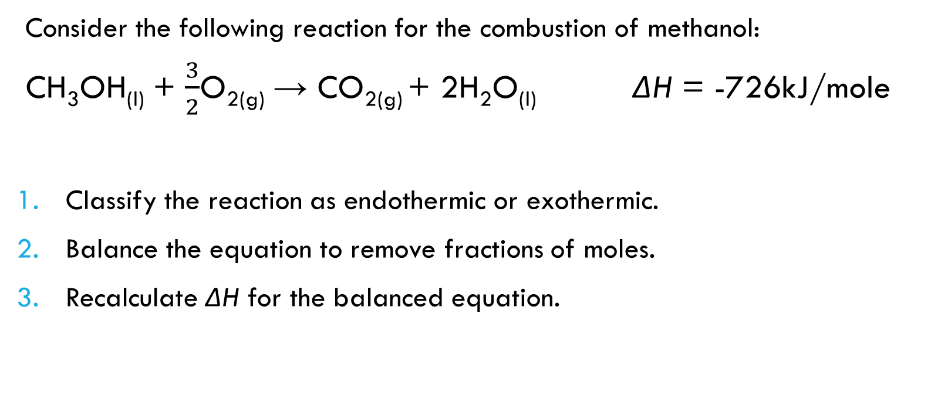
Your turn
Consider the following reaction for the combustion of methanol:
CH₃OH_{(l)} + $\frac{3}{2}$O_{2(g)} → CO_{2(g)} + 2H₂O_{(l)} ΔH = -726kJ/mole
Classify the reaction as endothermic or exothermic.
Balance the equation to remove fractions of moles.
Recalculate ΔH for the balanced equation.
Notes:
Exothermic
2CH₃OH_{(l)} + 3O_{2(g)} → 2CO_{2(g)} + 4H₂O_{(l)}
There are now twice as many moles of each substances, so the enthalpy will also double: ΔH = -726kJ/mole x 2 = -1452kJ/mole

